Slide 1

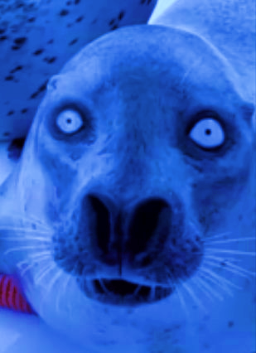
Photo Dup Finder
By: Alex Kohn, Cole Lowery, Nic Alabre, Christopher Munson

Slide 2
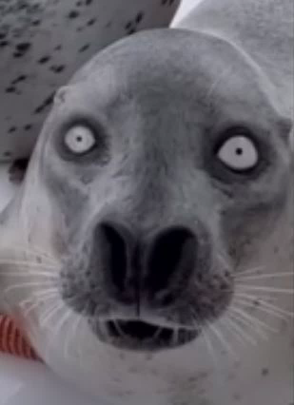
Overview
Purpose: Develop a desktop application that identifies exact duplicate and visually similar images within a selected folder.
Problem: Duplicate photos can accumulate over time, consume unnecessary storage space, and make photo collections difficult to organize.
Solution: Provide users with an accessible interface to locate, compare, and manage duplicate images.
Motivation: Simplify photo organization and reduce the time required to manually identify duplicate files.

Slide 3
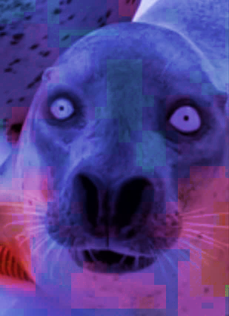
Core Features and Functionality
Folder Selection: Browse and select a folder for image scanning, with optional subfolder scanning.
Exact Duplicate Detection: Identify identical images through SHA-256 hashing.
Similar Image Detection: Compare images using perceptual hashing to identify visual similarities.
Image Previews: Display detected images with thumbnails, filenames, and file paths.
File Management: Allow users to select images to keep or delete.
Customization: Support light and dark interface themes.
Folder Comparison: Compare two folders and detect exact duplicates and similar duplicates

Slide 4
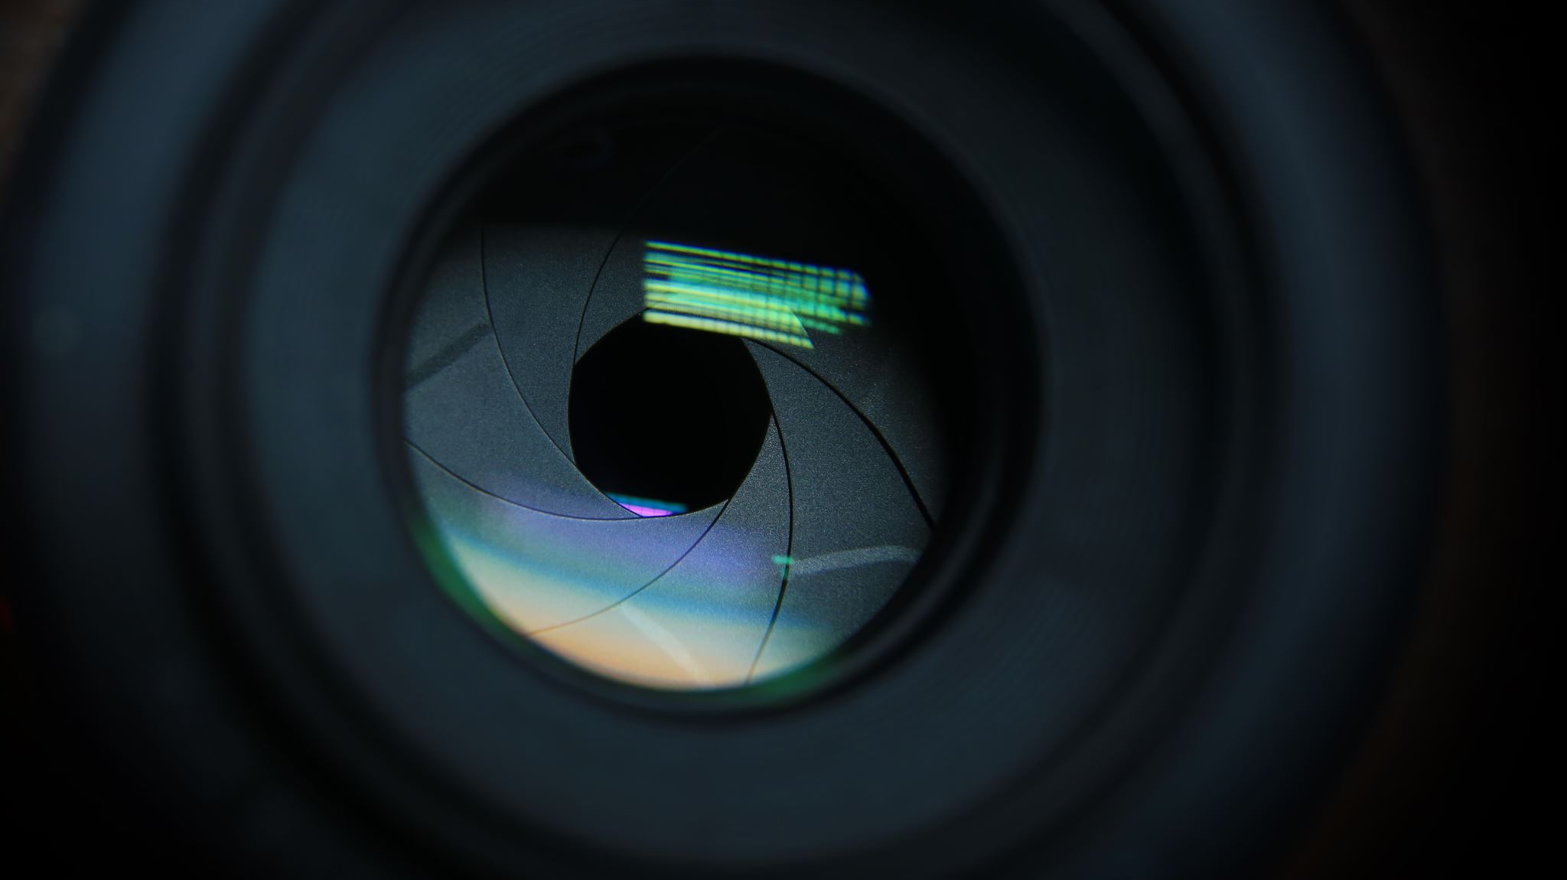
Demo

Slide 5

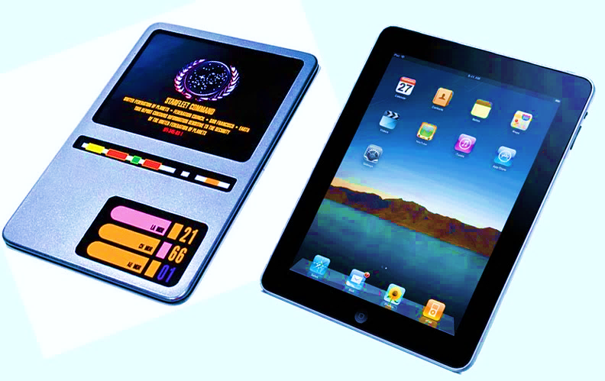
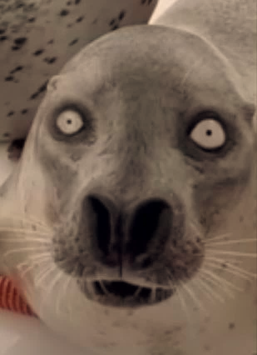
Technologies Used
Python - Primary coding language
Tkinter - Graphical user interface
Pillow - Loading, resizing, and displaying images
Hashlib (Sha256) - Detects exact duplicates
ImageHash - Detects similar images
Pathlib - Folder traversal and file management
Github - Version control
Visual Studio Code - Development environment

Slide 6
Feedback
Positive Feedback:
Customers found the application useful, unique, and easy to navigate.
Users appreciated the duplicate/similar image detection, subfolder scanning, and light/dark themes.
Multiple participants expressed interest in using the application.
Suggested Improvements:
GUI: Improve styling, button sizes, and checkbox visibility.
File Management: Simplify Keep/Delete selections and confirmations.
Image Viewing: Allow users to enlarge images for better comparison.
User Experience: Add a loading indicator during scans.
Future Features: Expand duplicate detection to videos.
Overall Takeaway: Customer feedback was generally positive, with most improvements focused on usability and interface refinement rather than core functionality.

Slide 7
Development Retrospective
What Went Well:
Successfully implemented exact and perceptual image hashing.
Developed a functional desktop interface for reviewing detected images.
Integrated multiple team contributions into one application.
Challenges Encountered:
Managing Python dependencies and different development environments.
Resolving Git merge conflicts during collaborative development.
Combining interface changes without disrupting existing functionality.
Designing intuitive image-selection and deletion controls.
Lessons Learned:
Frequent integration and testing help prevent conflicts between features.
User feedback is important for identifying usability problems.
Separating interface logic from image-processing logic improves maintainability.

